Slide 1
API Management
Warum, Was, Wie?

Slide 2






Über uns
Daniel Wagner
Anton Kalcik
daniel_wagn3r
akalcik
kalcik.net

Slide 3
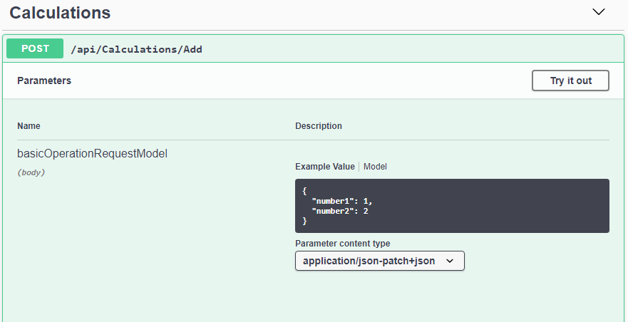
API What?
Interface inside a component
public interface Calculator
{
int Add(int summand1, int summand2);
int Sub(int minuend, int subtrahend);
}
Interface provided by a component

Slide 4
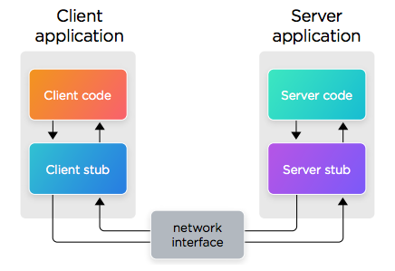
History by Example
Pattern used by e.g.
RPC
CORBA
Java RMI
Quelle: https://dzone.com/articles/the-evolution-of-systems-integration

Slide 5



Wie funktioniert API Management
Backend APIs
Third Party APIs
Application
API Management

Slide 6
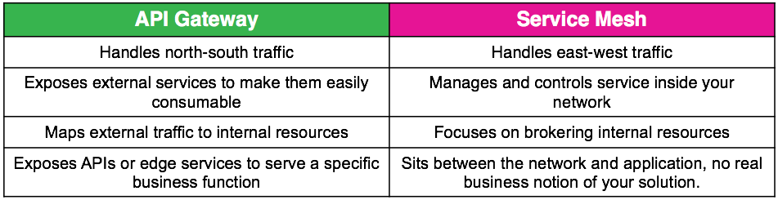
Wann API Management
Quelle: https://dzone.com/articles/api-gateway-vs-service-mesh

Slide 7
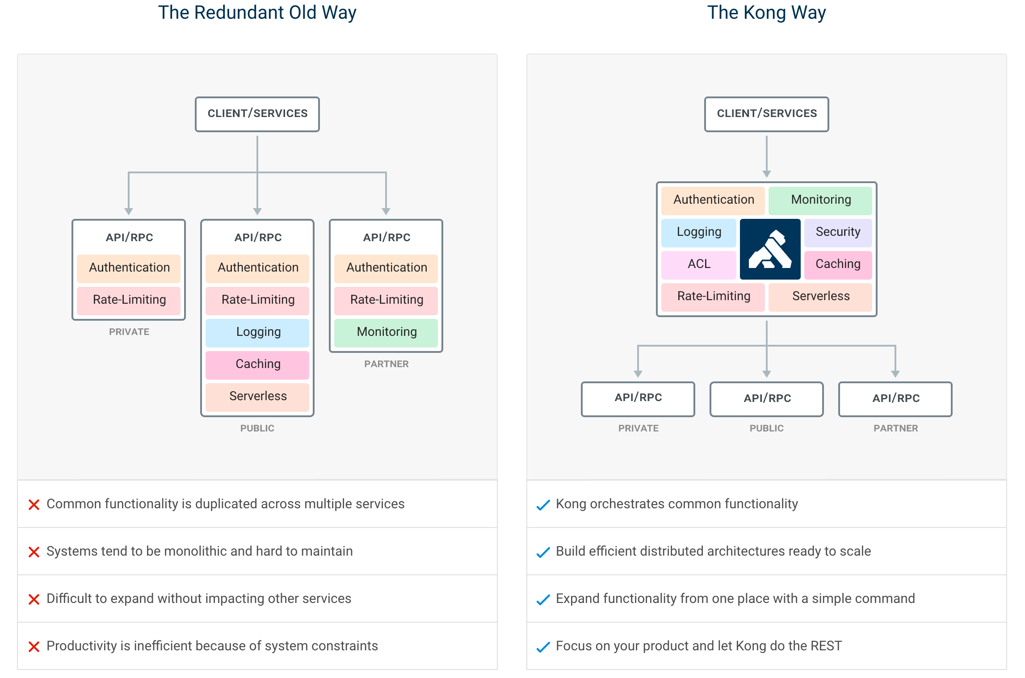
Traditional vs. Managed APIs
Quelle: https://github.com/kong/kong

Slide 8
Warum Api Management
Daten monetarisieren
Trends erkennen
Third party Engagement
Legacy modernisieren
Zerlegung von Monolithen
Sicherheit gewährleisten
Eingrenzen und Erweitern

Slide 9
Example Kong
open source API gateway
In fact it's fremium
smaller feature set
essentials are there
traffic control
security
logging
monitoring
...
Quelle: https://www.thoughtworks.com/radar/tools/kong-api-gateway

Slide 10

Limits of API Management
Avoid:
Business Smart in Middle Ware
Complex programming in unsuitable environments
Designs which are difficult to test and deploy
Siehe: https://www.thoughtworks.com/radar/platforms/overambitious-api-gateways

Slide 11

Beispiele
github.com/danielwagn3r/apimgmt-workshop

